Slide 1
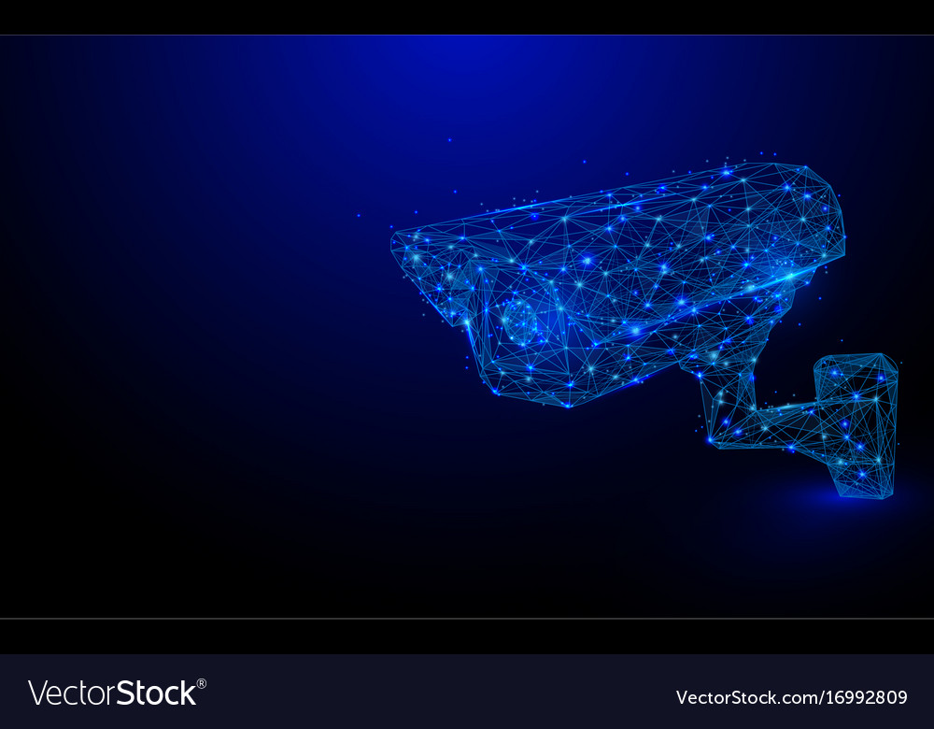
TRIPLE CARRY AVOIDANCE
1

Slide 2




College Name
SRM Institute of Science and Technology​
Jadavpur University​
Indian Institute of Engineering Science and Technology
2

Slide 3


PROFESSOR IN CHARGE
NAME Dr K. Kalimuthu.
EMAIL ID kalimutk@srmist.edu.in .
DISCIPLINE Electronics and communication engineering.
YEAR Not applicable.
MOBILE 98416 31531
3

Slide 4
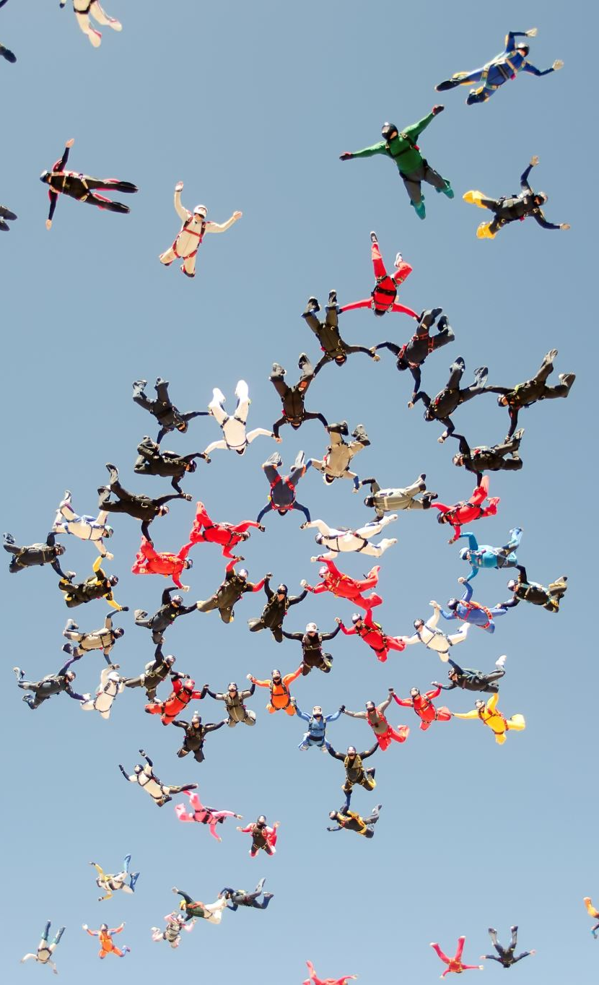
Team member details
4

Slide 5

TEAM MEMBER 1
NAME Aryan N
EMAIL ID panakalaryan@gmail.com
DISCIPLINE CSE Cloud Computing
YEAR 3rd year
MOBILE 9978115598
5

Slide 6
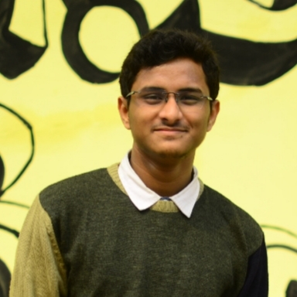
TEAM MEMBER 2
NAME Abhishek Sarkar
EMAIL ID abhisrkr007@gmail.com
DISCIPLINE Electronics and telecommunication engineering
YEAR 3rd year
MOBILE 6290782054
6

Slide 7
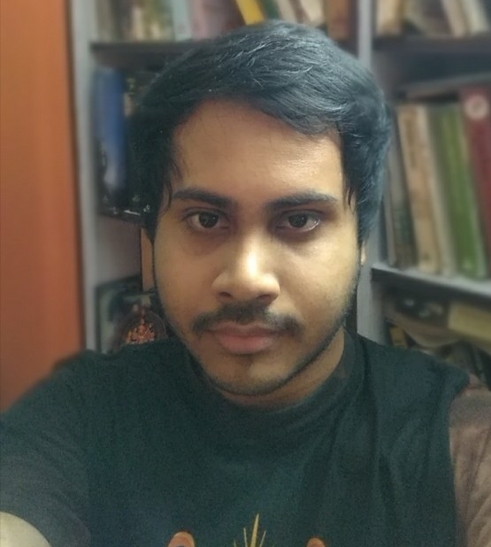
TEAM MEMBER 3
NAME Ahel Das Chatterjee
EMAIL ID aheldc@gmail.com
DISCIPLINE Department of Computer Science and Technology
YEAR 3rd year
MOBILE 8617791548
7

Slide 8

TEAM MEMBER 4
NAME Ved Prakash Dubey
EMAIL ID dvedprakash2001@gmail.com
DISCIPLINE CSE-SWE
YEAR 3rd year
MOBILE 9674990810
8

Slide 9
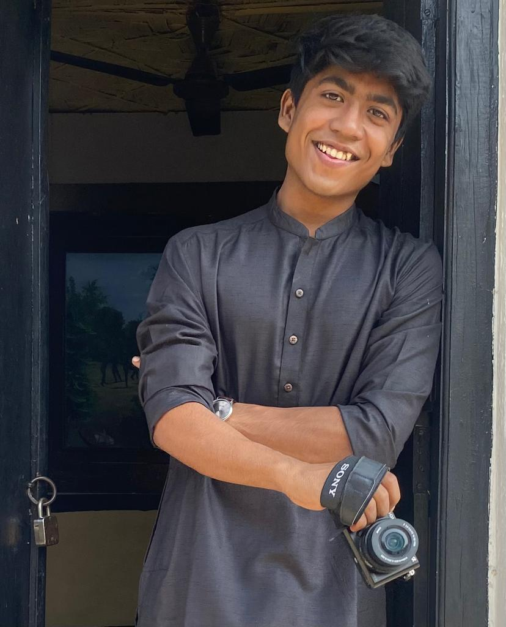
TEAM MEMBER 5
NAME Pushpal Das
EMAIL ID pushpaldas2001@gmail.com
DISCIPLINE Electronics and Communication Engineering
YEAR 3rd year
MOBILE 8910497557
9

Slide 10
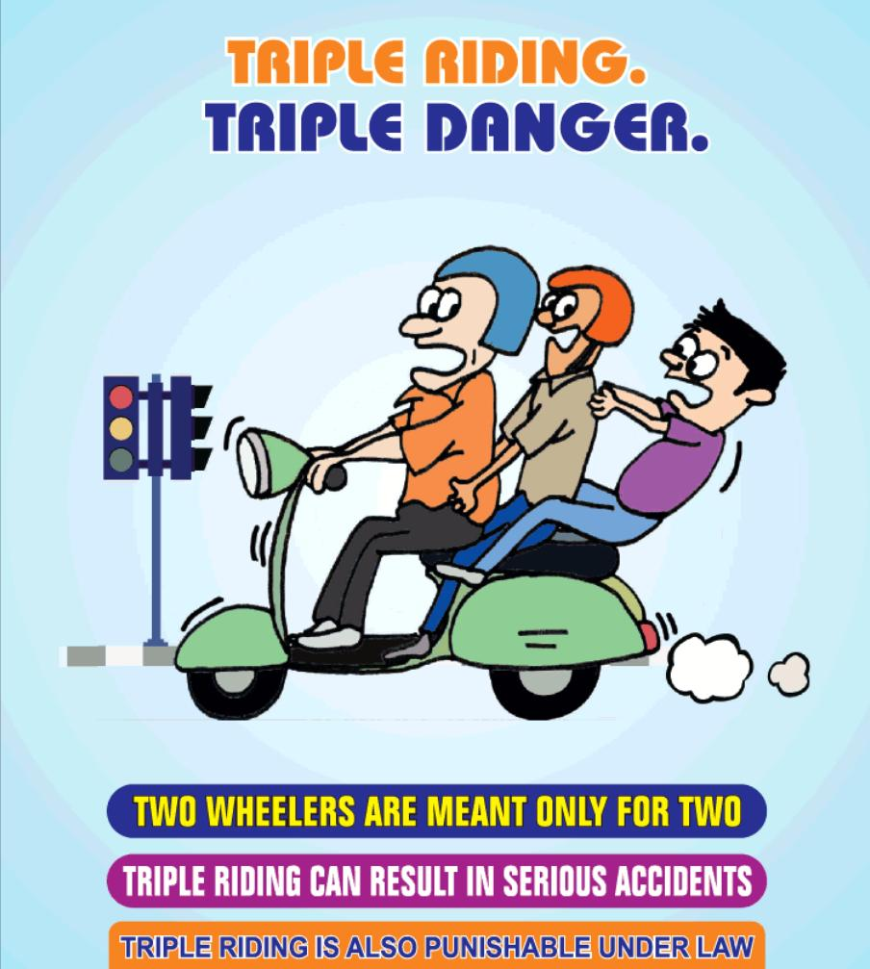
ABSTRACT
In many states the traffic signals have been upgraded into smarter solutions, but real-time surveillance and regulation of traffic rule offenders is yet to be seen.
Triple carry is prohibited by law in our country, and yet the offense is rarely talked about and looked upon by the traffic police.
It is not only illegal, but also risky and dangerous for multiple people. The motorcycle driver along with two riders pose risk to their own lives as well as that of other people. This is because when a motorcycle that is meant to carry two people gets the load of three, it loses its structural balance and the suspension poses risk of damage.
This phenomenon is widely seen in small localities where people need not travel long distances. Such a place where we tried to bring smarter surveillance and regulation was our university campus in Tamil Nadu, India.
10

Slide 11

INTRODUCTION
Triple carry on two wheeler inside SRM Institute of Science and Technology, Kattankulathur
The university provides guards present at the entry gate to the campus for identity verification, for safety standards - like checking body temperature for covid, wearing a helmet when you are on a two wheeler, and checking whether there is any triplet on the bike before entering to the campus.
But it is generally outside the campus at the gates where one can get access for checking for triple carry and not inside the campus as it is not possible for guards to check at each and every turn inside the large area of the campus.
So in most of the cases, for students who carry a third person on their bikes outside the campus, when they reach near the checking point on the gate, they drop one and enter successfully without scrutiny carrying the other person in their bikes.
On the other hand the other rider enters the campus on foot and again gets up on the bike, resulting in a triple carry. Thus, the checking near the entrance gate is not efficient when it comes to curbing triple carry.
11

Slide 12
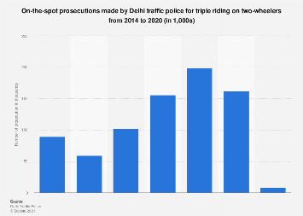
GRAPHICAL ANALYSIS
12

Slide 13
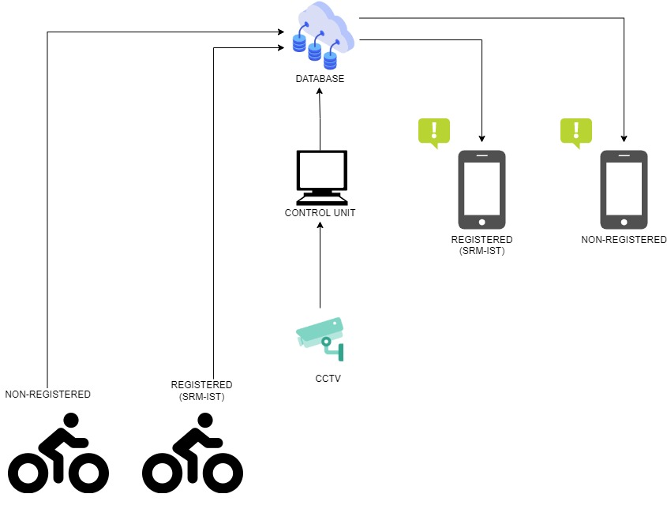
Overall system for detection and storage of violation
13

Slide 14
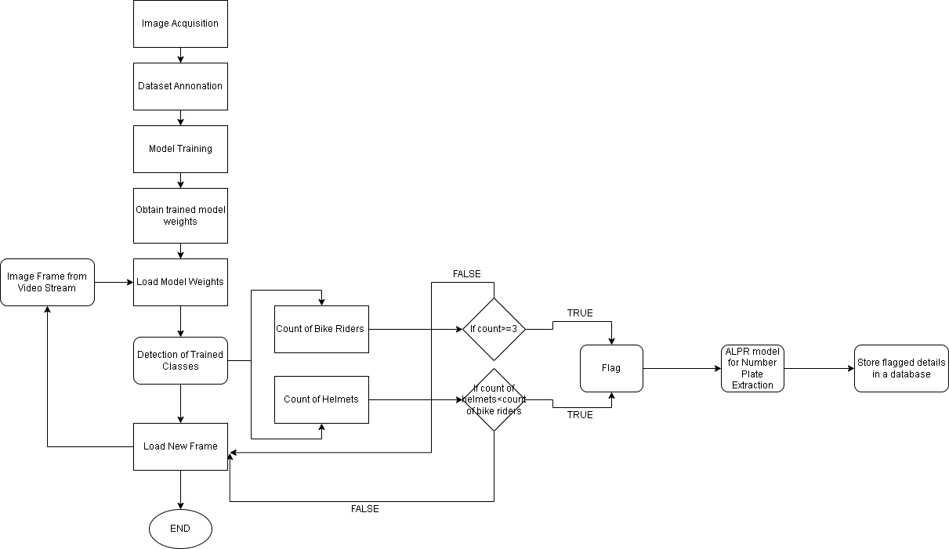
M
E
T
H
O
D
O
L
O
G
Y
Object detection is the craft of detecting instances of a certain class, like animals, humans and many more in an image or video.
The Pre-Existing Object Detection API makes it easy to detect objects by using pre-trained object detection models. But these models detect several objects which are of no use to us, therefore in order to detect the necessary classes, a custom object detector becomes necessary.
(refer)Object detection alludes to the ability of computer and programming frameworks to find objects in a picture/scene and recognize each article.
Object detection has been broadly utilized for face detection, vehicle detection, pedestrian, web pictures, security frameworks, and driverless vehicles. Numerous ways of object detection can be utilized too in many fields of training.
Like every other computer innovation, a wide scope of imaginative and astounding employments of object detection will come from the endeavors of computer software engineers and programming designers.
14

Slide 15
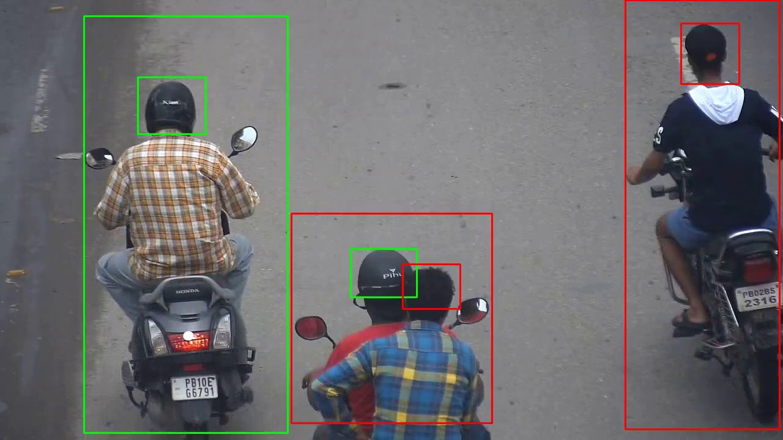
M
E
T
H
O
D
O
L
O
G
Y
The forward leap and quick reception of deep learning in 2012 brought into reality the present day and exceptionally precise object detection calculations and techniques, for example, R-CNN, Fast-RCNN, Faster-RCNN, RetinaNet, and quick yet profoundly exact ones like SSD and YOLO.
Utilizing these techniques and calculations, in light of deep learning which is additionally founded on AI requires loads of numerical and deep learning systems understanding. There are a huge number of master software engineers and programming designers that need to coordinate and make new items that utilize object detection. However, this innovation is kept out of their hands because of the extra and complicated way to understand and utilize it.
In order to implement helmet detection and number plate recognition and extraction, a multitude of objects need to be detected and some of them counted. The objects are – Motorbike, Helmet (Count of the Helmets), People on the Bike (Count of the People) and License Plate. (refer)
15

Slide 16
M
E
T
H
O
D
O
L
O
G
Y
Numerous scientists have additionally proposed a strategy that includes the detection of motorcyclists, trailed by checking whether or not the motorcyclist wears a protective cap. For the detection of moving objects, the creators have proposed a foundation deduction technique to remove the moving object and arrange them by separating highlights utilizing Local Binary Pattern (LBP).
In the wake of getting the motorbike, the 1/5 of the picture from the top was edited to get the cap area and characterized it utilizing HOG, Hough Transform, and LBP descriptors.
16

Slide 17
Algorithm to detect violation using image processing and to store the details into database
17

Slide 18
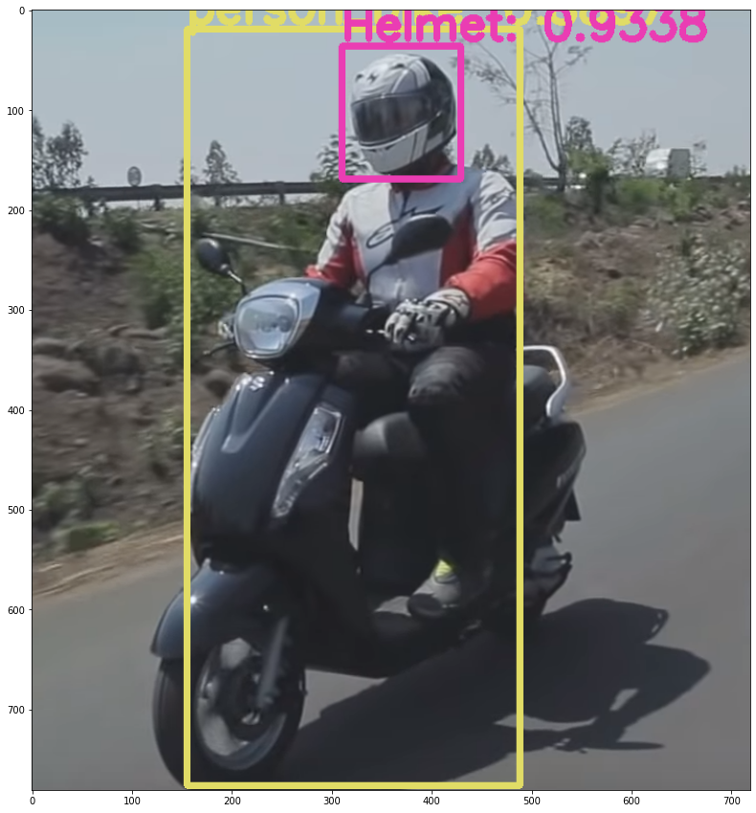
M
E
T
H
O
D
O
L
O
G
Y
Particular Approach
Case 1: Person Detection and Counting
Our first YOLOv3 model is trained on data consisting of images annotated with bounding boxes around motorcycles. Once the model detects the motorcycles the entire area bound is cropped using OpenCV so that it can be processed further to detect the number of people riding it and the number of people wearing helmets.
18

Slide 19
M
E
T
H
O
D
O
L
O
G
Y
Case 2:
Helmet Detection and Counting vs No. of Riders
A combination of object tracking and object detection in a single algorithm must be used to accurately detect triple carry. Using OpenCV the number of people entering the frame of a CCTV camera can be counted.
For the detection of moving objects, the creators have proposed a foundation deduction technique to remove the moving object and arrange them by separating highlights utilizing Local Binary Pattern (LBP). In the wake of getting the motorbike, the 1/5 of the picture from the top was edited to get the cap area and characterized it utilizing HOG, Hough Transform, and LBP descriptors.
If the number of people exceeds two, or the riders do not wear helmets, the image frames were sent for number plate detection.
19

Slide 20
M
E
T
H
O
D
O
L
O
G
Y
Case 3: Number Plate Extraction and Storage for Flagged Users
Once it has been checked for triple riding on a two-wheeler in a single image frame, we need to extract the number plates of the vehicle. There are deep learning-based tools like EasyOCR in Python that allows us to extract text from an image conveniently. EasyOCR performs very well on invoices, handwriting, car plates, and public signs. Even big tech companies have their own services like Google Vision, Microsoft Computer Vision APIs to extract the images.
One of the major drawbacks in this method is the quality of images.So, deep learning algorithms can be used to convert low-resolution images to high resolution images. RAISR, an algorithm released by Google, combines traditional upsampling with deep learning to change low-resolution images into high-resolution counterparts.
20

Slide 21
M
E
T
H
O
D
O
L
O
G
Y
Another company, WaveOne, has trained a model to compress images to small sizes, with more success than JPEG.
So, the images need to be converted to high resolution before being sent for text detection.
The CCTV camera is supposed to store visual data in digital format in its storage medium. The SoC would preferably also have an image sensing unit connected to the image sensor of the camera that would process the visual data received and accordingly adjust the focus and exposure to get the best possible result.
If and when a captured image is blurred, sharpening would be done on the image to reinforce the edges of the objects by performing a matrix-based calculation on the digital image.
21

Slide 22
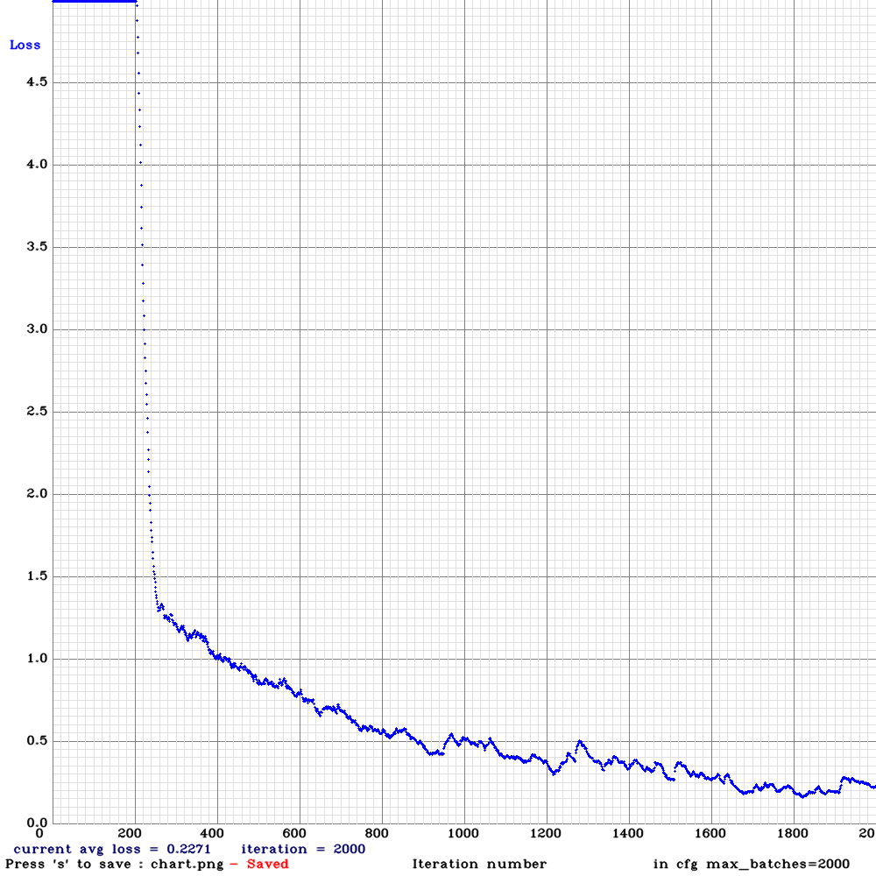
Person Detection and Helmet counting in Use
Models in Use
Loss vs Iterations for Rider Detection Model
Video link-
22

Slide 23
R E S U L T
Number Plate Extraction and Storage for Flagged Users.
23

Slide 24
R E S U L T
The three YOLOv3 models were trained using Darknet, an object detection library written in C/C++. All models were converging after roughly 1500 epochs and standardized well to the given use cases. Training newer more improved models with manually annotated datasets specific to our target locations would yield a model more well-suited to our needs.
24

Slide 25
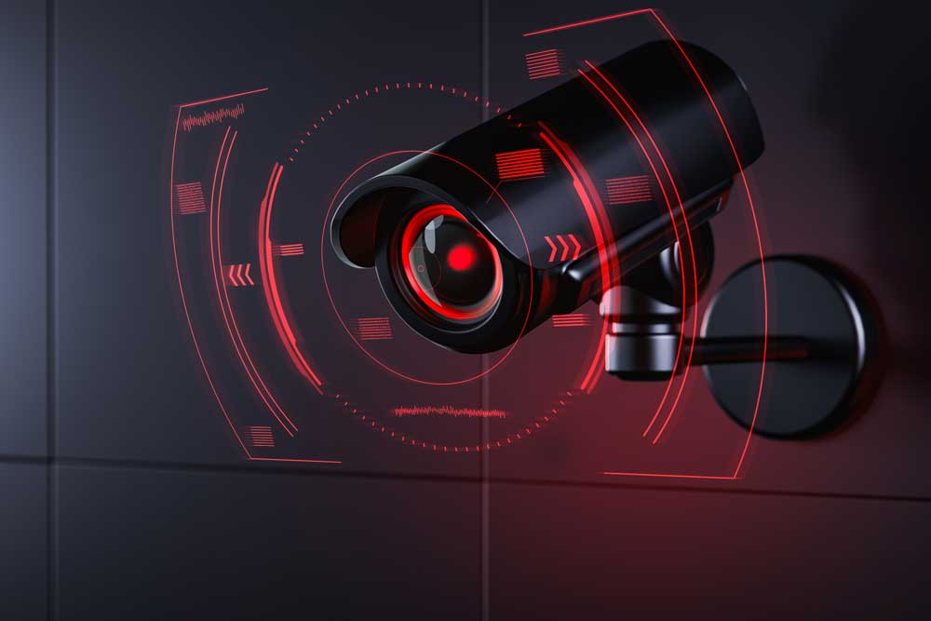
C O N C L U S I O N
As mentioned, triple carry on two-wheelers has been made a punishable and fineable offense across the country and is being enforced strictly. This is due to various reasons ranging from personal to civic safety that is endangered by triple riding on a bike. This makes it all the more important to ensure that through technology we can help in better and more efficient enforcement of this law on our campus. Our technology can bring down the number of repeat offenders. This technology can also be applied throughout the country and potentially help in decreasing one of the major causes of bike or traffic accidents.
25

Slide 26
26

Slide 27
F U T U R E WORK
For customized applications, the digital image processor would be integrated onto a compact system on chip in the CCTV along with the central processing unit that would contain the program to extract the required data like number plate and send it to the centralized database.
The database server should be configured to send messages and emails directly to the number and e-mail ID associated with the offender's number plate when there is an update. This can be done by running an SQL query to retrieve the relevant information, which is then sent in the form of a notice by putting the information in placeholders of a pre-written text message.
The CCTV camera is supposed to store visual data in digital format in its storage medium. The SoC would preferably also have an image sensing unit connected to the image sensor of the camera that would process the visual data received and accordingly adjust the focus and exposure to get the best possible result.
If and when a captured image is blurred, sharpening would be done on the image to reinforce the edges of the objects by performing matrix-based calculation on the digital image.
27

Slide 28
R
E
S
O
U
R
C
E
S
Website
• India: triple riding prosecutions by Delhi traffic police 2020 | Statista
Mission Road Safety on Twitter: "Tripple riding is not only dangerous for whoever rides but also to the other people around them. Don't indulge in tripple riding or over loading on two wheelers. https://t.co/CvVa1qxx77" / Twitter
SRM Institute of Science and Technology releases engineering rank list | The News Minute
Stanley focuses on the future of remote monitoring | SecurityWorldMarket.com
28

